Slide 1
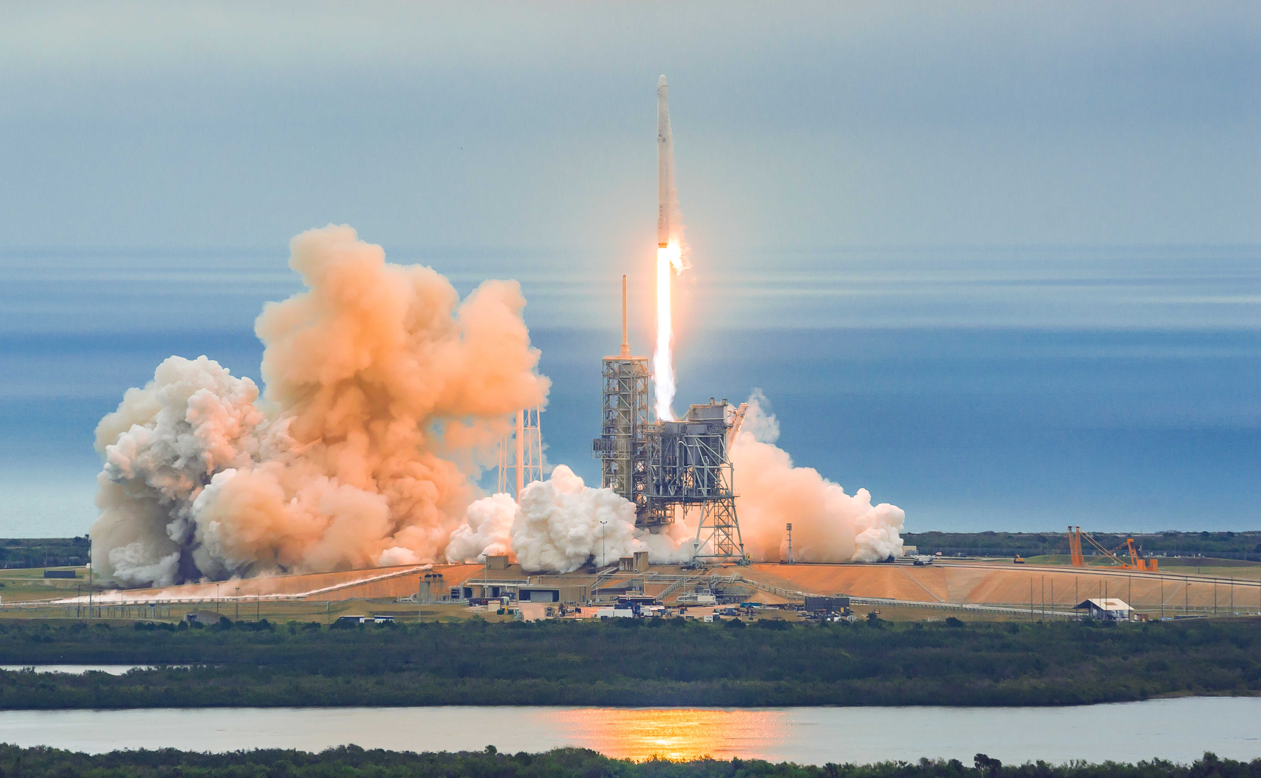
IBM Applied Capstone Project
By Sam Weller

Slide 2
Outline
Executive Summary
Introduction
Methodology
Results
Discussion
Conclusion

Slide 3
Executive Summary
In this capstone project, my main adjective was to predict if the SpaceX Falcon 9, will land successfully using machine learning techniques and past data.
The steps were as follows:
Data collection, data wrangling, data formatting
Exploratory data analysis
Data visualization
Machine learning prediction
We concluded that using a decision tree model would be the most accurate prediction model based on our training and test set.

Slide 4
Introduction
In this capstone project, we will be predicting if the Falcon 9 rocket will land successfully. The Falcon 9 project is revolutionary because its cost is substantially cheaper than it would be for other competitor rockets. It costs 62 million to produce while others cost around 150 million. The reason it is able to save so much money is because of it is able to reuse the first stage. .
What we are trying to answer is, for a set of features on the Falcon 9 rocket such as payload mass, orbit type, launch type, etc… will the rocket land successfully?

Slide 5
Methodology
The overall methodology is as follows:
Data collection, wrangling, and formatting, using:
SpaceX API
Web scraping
Exploratory data analysis (EDA), using:
Pandas and NumPy
SQL
Data visualization, using:
Matplotlib and Seaborn
Folium
Dash
Machine learning prediction, using:
Logistic regression
Support vector machines (SVM)
Decision tree
K-nearest neighbors (KNN)

Slide 6
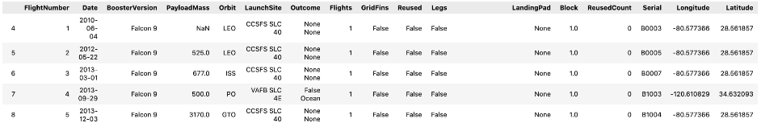
Methodology 1: Data collection, wrangling and formatting
The API used is https://api.spacexdata.com/v4/launches/pa
This API provides data about many different types of rockets done by SpaceX so we had to filter it down to only include Falcon 9 launches.
Whenever there was missing data, we replaced it with the mean of the column.
The end result was 90 rows (instances) with 17 columns (features).

Slide 7
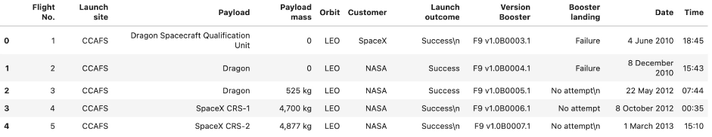
Methodology 1: Data collection, wrangling and formatting
For web scraping we used the data from: List of Falcon 9 and Falcon Heavy launches – Wikipedia
This website contains data only from Falcon 9 launches.
We ended up with 121 rows (instances) and 11 columns (features).

Slide 8



Methodology 2: Exploratory Data Analysis (EDA)
Pandas and NumPy
Used to derive information about the data collected including:
Number of occurrences of each orbit
Each mission’s outcome
Number of launches on each launch site
SQL
Used to answer several questions of the data such as:
Names of unique launch sites
Total mass carried by the boosters launched by NASA (CRS)
Average mass carried by booster version F9 v1.1

Slide 9



Methodology 3: Data visualization
Matplotlib and Seaborn
Used to visualize data through scatterplots, bar charts, and line charts to understand relationships between:
Relationship of payload mass and launch site
Relationship of success and orbit type
Relationship of flight number and launch site
Folium
Used to visualize data through interactive maps such as:
Marking all launch sites on a map
Mark the succeeded and failed launches on a map
Mark the distances of each launch site to things like cities and roads

Slide 10

Methodology 4: Machine Learning & Prediction
Used Scikit-learn library to create machine learning models which include:
Logistic regression
Support vector machine (SVM)
Decision tree
K nearest neighbors (KNN)
Fitted the models between training and test sets to predict which models has the best accuracy scores also using a confusion matrix

Slide 11
Results
The results are split up into 4 different sections
SQL (Exploratory Data Analysis)
Matplotlib and Seaborn (Exploratory Data Analysis with Visualization)
Folium
Predictive Analysis

Slide 12
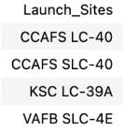
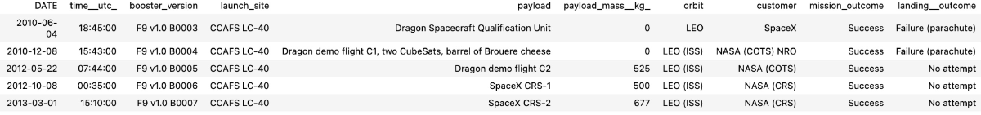
Results 1: Exploratory Data Analysis with SQL
Names of launch sites
Records where launch sites begin with ‘CCA’

Slide 13



Results 1: Exploratory Data Analysis with SQL
Total payload mass carried by boosters launched by NASA (CRS)
Average payload mass carried by booster version F9 v1.1
Date of first successful landing outcome in ground pad

Slide 14
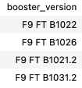

Results 1: Exploratory Data Analysis with SQL
Names of boosters which have success in drone ship and payload pass in range of 4000-6000 pounds
Total number of successful and failed mission outcomes

Slide 15
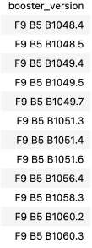
Results 1: Exploratory Data Analysis with SQL
Names of booster versions which have carried the maximum payload mass

Slide 16

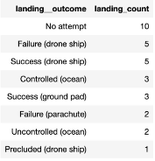
Results 1: Exploratory Data Analysis with SQL
Failed landing outcomes in drone ship, their booster versions, and launch site names in 2015
Count of landing outcomes between date 2010 -2017 (descending order)

Slide 17
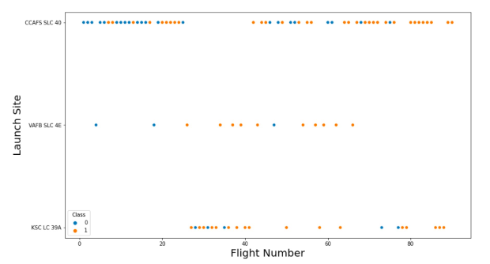
Results 2: Matplotlib and Seaborn Visualization
Relationship between flight number and launch site

Slide 18
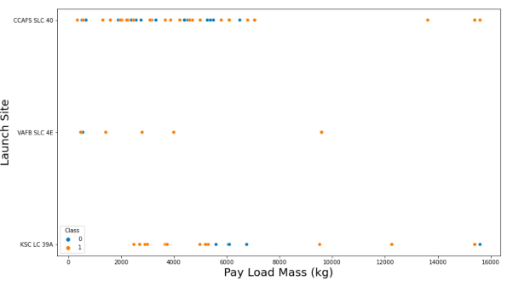
Results 2: Matplotlib and Seaborn Visualization
Relationship between payload mass and launch site

Slide 19
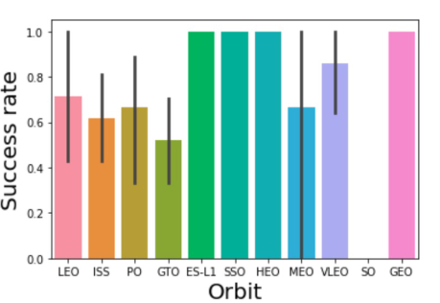
Results 2: Matplotlib and Seaborn Visualization
Relationship between success rate and orbit type

Slide 20
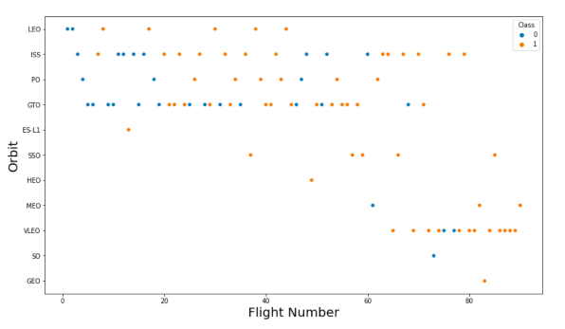
Results 2: Matplotlib and Seaborn Visualization
Relationship between flight number and orbit type

Slide 21
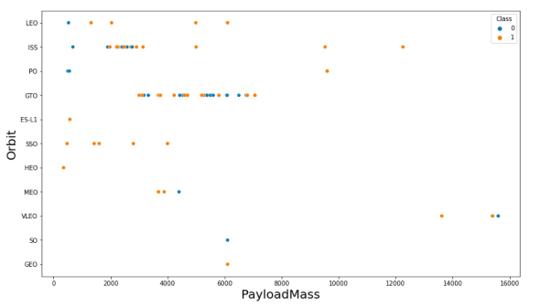
Results 2: Matplotlib and Seaborn Visualization
Relationship between payload mass and orbit type

Slide 22
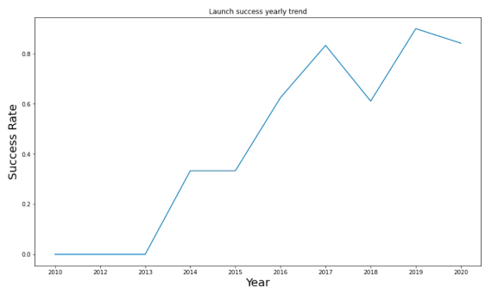
Results 2: Matplotlib and Seaborn Visualization
Launch success yearly trend

Slide 23
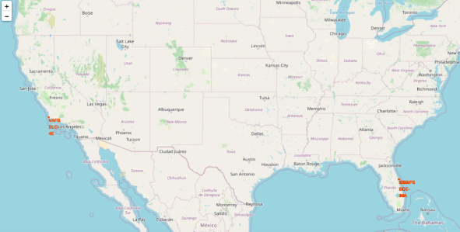
Results 3: Folium
All launch sites on map

Slide 24
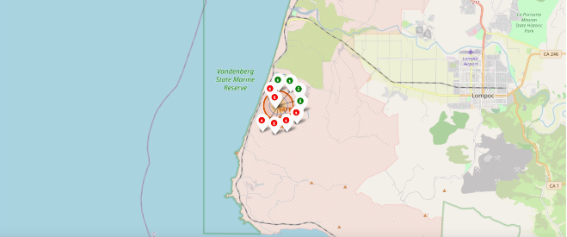
Results 3: Folium
The succeeded launches and failed lunches for each site on the map.
Green is a successful launch
Red is a failed launch

Slide 25
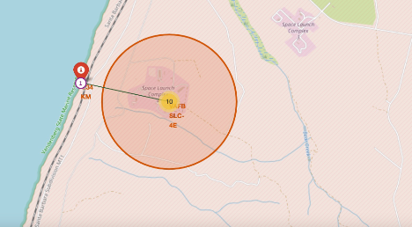
Results 3: Folium
Distances between launch site to proximities such as cities or major roads

Slide 26
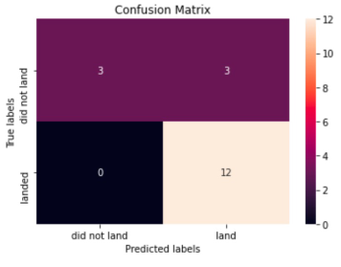
Results 4: Prediction Analysis with Scikit Learn
Logistic regression
GridSearchCV best score: .846428
Accuracy score on test set: .833333
Confusion matrix:

Slide 27
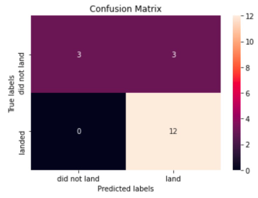
Results 4: Prediction Analysis with Scikit Learn
Support vector machine (SVM)
GridSearchCV best score: .848214
Accuracy score on test set: .833333
Confusion matrix:

Slide 28
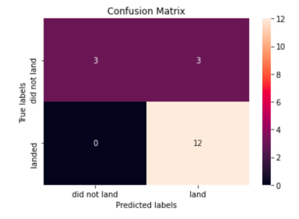
Results 4: Prediction Analysis with Scikit Learn
Decision tree
GridSearchCV best score: .889285
Accuracy score on test set: .833333
Confusion matrix:

Slide 29
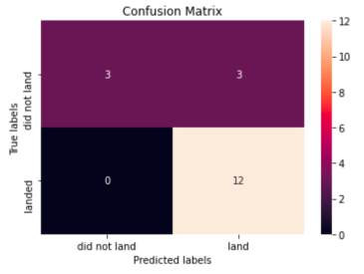
Results 4: Prediction Analysis with Scikit Learn
K nearest neighbors (KNN)
GridSearchCV best score: .848214
Accuracy score on test set: .833333
Confusion matrix:

Slide 30
Results 4: Prediction Analysis with Scikit Learn
After all of this we can compare the four models and see that they all have the same accuracy score and confusion matrix based on the test set
Because of this we have to use the GridSearchCV scores to rank them instead. The rankings are as follows (1 being best, 4 being worst):
Decision Tree: .889285
K Nearest Neighbors: .848214
Support Vector Machine: .848214
Logistic Regression: .846428

Slide 31
Conclusion
Overall, we tried to predict if the first stage of a Falcon 9 launch will land or not to help determine the cost of launch
There are numerous features that go along with the Falcon 9 launch and they have their own unique affect on the mission outcome
We used several machine learning algorithms to learned the patters of past Falcon 9 launches to produce predictive models to see if a Falcon 9 will land successfully
After splitting up the data into training and test sets, we determined that the decision tree algorithm is the best out of the 4 learning algorithms we used.

